Slide 1

Miracles Around the Lake
2024 Quarter 3 Lesson 05
Mark 4, 5, 6

Slide 2
Miraculous Authority
As we return to a study of Jesus’ miraculous works, it seems inevitable that we return to an examination of Jesus’ authority. We’ve already discussed in detail Jesus’ authority as a teacher, which is extended to those who follow Him. We’ve also seen examples of His authority to forgive sins, which belongs solely to Him as God. What kind of authority is represented in these stories?

Slide 3
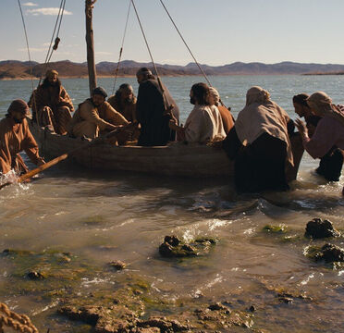
Authority Over the Sea
Mark 4:36-41
36 And when they had sent away the multitude, they took him even as he was in the ship. And there were also with him other little ships.

Slide 4
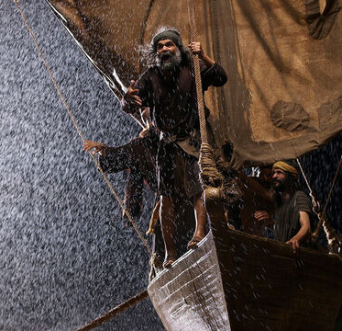
Authority Over the Sea
Mark 4:37-41
37 And there arose a great storm of wind, and the waves beat into the ship, so that it was now full.

Slide 5
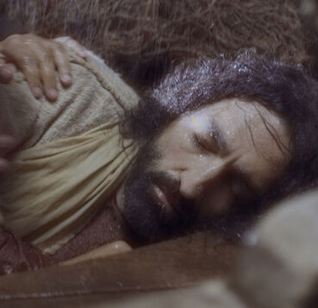
Authority Over the Sea
Mark 4:38-41
38 And he was in the hinder part of the ship, asleep on a pillow: and they awake him, and say unto him, Master, carest thou not that we perish?

Slide 6
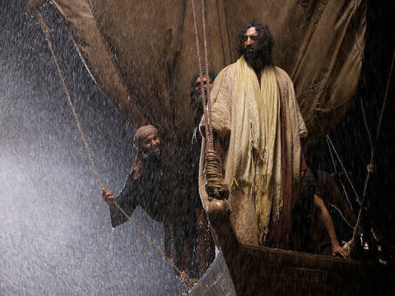
Authority Over the Sea
Mark 4:39-41
39 And he arose, and rebuked the wind, and said unto the sea, Peace, be still. And the wind ceased, and there was a great calm.

Slide 7
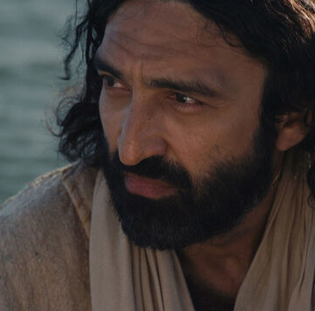
Authority Over the Sea
Mark 4:40-41
40 And he said unto them, Why are ye so fearful? how is it that ye have no faith?

Slide 8
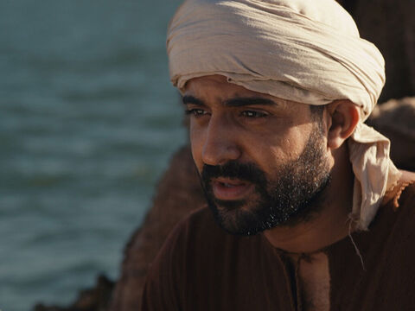
Authority Over the Sea
Mark 4:41
41 And they feared exceedingly, and said one to another, What manner of man is this, that even the wind and the sea obey him?

Slide 9
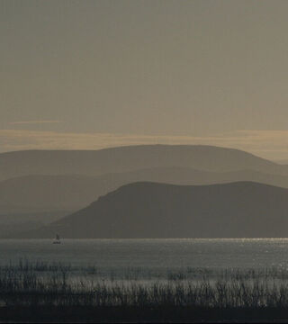
Authority Over the Sea
Desire of Ages p. 335
The boats that had set out to accompany Jesus had been in the same peril with that of the disciples. Terror and despair had seized their occupants; but the command of Jesus brought quiet to the scene of tumult.

Slide 10
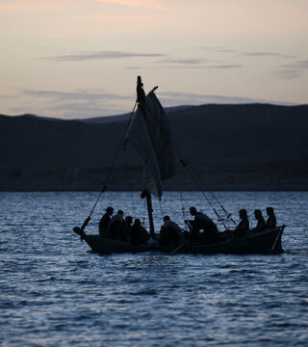
Authority Over the Sea
Desire of Ages p. 335
The fury of the storm had driven the boats into close proximity, and all on board beheld the miracle. In the calm that followed, fear was forgotten.

Slide 11
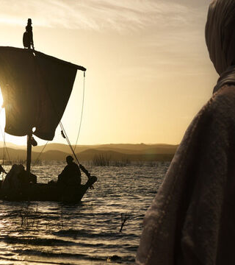
Authority Over the Sea
Desire of Ages p. 335
The people whispered among themselves, “What manner of man is this, that even the winds and the sea obey Him?”

Slide 12
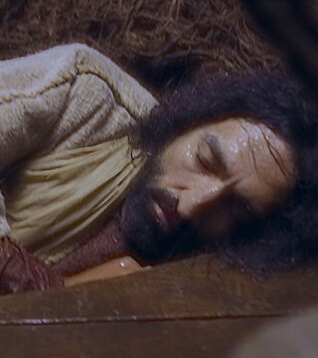
Whose Authority?
Desire of Ages p. 336
When Jesus was awakened to meet the storm, He was in perfect peace. There was no trace of fear in word or look, for no fear was in His heart. But He rested not in the possession of almighty power. It was not as the “Master of earth and sea and sky” that He reposed in quiet.

Slide 13
Whose Authority?
Desire of Ages p. 336
That power He had laid down, and He says, “I can of Mine own self do nothing.” John 5:30. He trusted in the Father's might. It was in faith—faith in God's love and care—that Jesus rested, and the power of that word which stilled the storm was the power of God.

Slide 14
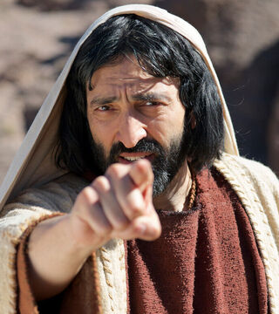
Whose Authority?
Matthew 17:20
20 And Jesus said unto them, Because of your unbelief: for verily I say unto you, If ye have faith as a grain of mustard seed, ye shall say unto this mountain, Remove hence to yonder place; and it shall remove; and nothing shall be impossible unto you.

Slide 15
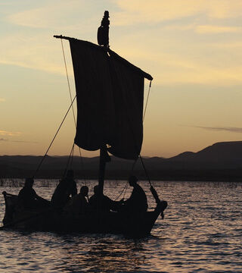
Whose Authority?
Mark 16:17-18
17 And these signs shall follow them that believe; In my name shall they cast out devils; they shall speak with new tongues;
18 They shall take up serpents; and if they drink any deadly thing, it shall not hurt them; they shall lay hands on the sick, and they shall recover.

Slide 16
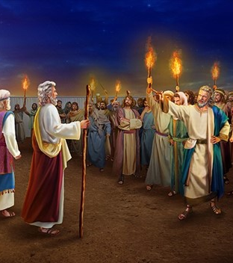
Whose Authority?
Numbers 16:28-33
28 And Moses said, Hereby ye shall know that the Lord hath sent me to do all these works; for I have not done them of mine own mind.
29 If these men die the common death of all men, or if they be visited after the visitation of all men; then the Lord hath not sent me.

Slide 17
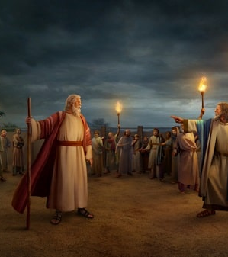
Whose Authority?
Numbers 16:30-33
30 But if the Lord make a new thing, and the earth open her mouth, and swallow them up, with all that appertain unto them, and they go down quick into the pit; then ye shall understand that these men have provoked the Lord.

Slide 18
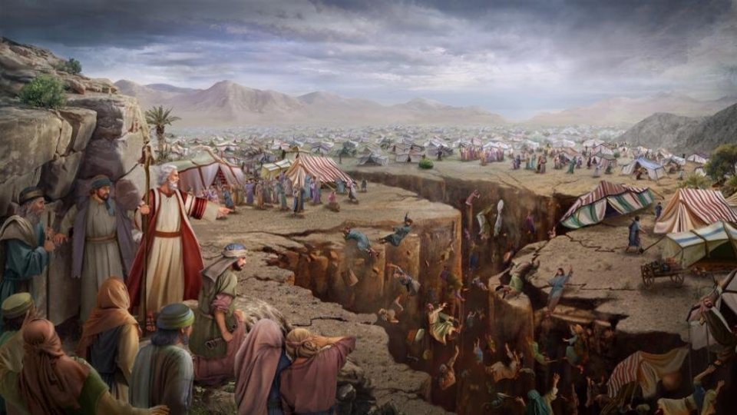
Whose Authority?
Numbers 16:31-33
31 And it came to pass, as he had made an end of speaking all these words, that the ground clave asunder that was under them:

Slide 19
Whose Authority?
Numbers 16:32-33
32 And the earth opened her mouth, and swallowed them up, and their houses, and all the men that appertained unto Korah, and all their goods.

Slide 20
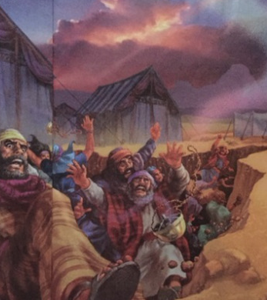
Whose Authority?
Numbers 16:33
33 They, and all that appertained to them, went down alive into the pit, and the earth closed upon them: and they perished from among the congregation.

Slide 21
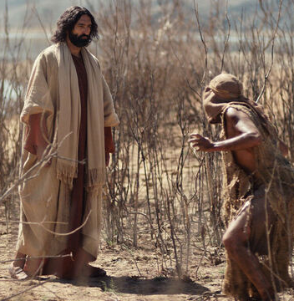
Authority over Evil
Mark 5:1-20
1And they came over unto the other side of the sea, into the country of the Gadarenes.
2 And when he was come out of the ship, immediately there met him out of the tombs a man with an unclean spirit,

Slide 22
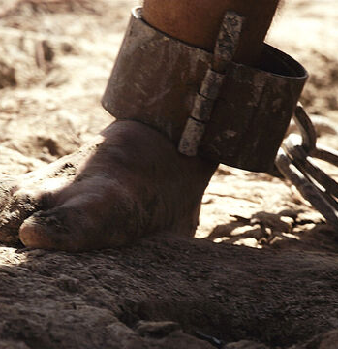
Authority over Evil
Mark 5:3-20
3 Who had his dwelling among the tombs; and no man could bind him, no, not with chains:
4 Because that he had been often bound with fetters and chains, and the chains had been plucked asunder by him, and the fetters broken in pieces: neither could any man tame him.

Slide 23
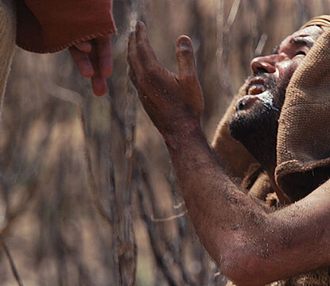
Authority over Evil
Mark 5:5-20
5 And always, night and day, he was in the mountains, and in the tombs, crying, and cutting himself with stones.
6 But when he saw Jesus afar off, he ran and worshipped him,

Slide 24
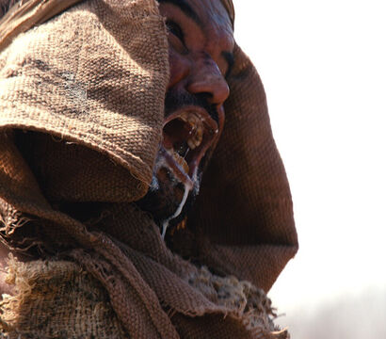
Authority over Evil
Mark 5:7-20
7 And cried with a loud voice, and said, What have I to do with thee, Jesus, thou Son of the most high God? I adjure thee by God, that thou torment me not.

Slide 25
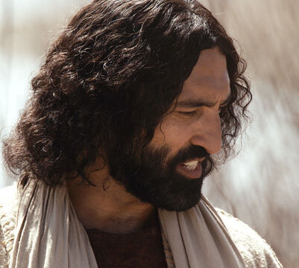
Authority over Evil
Mark 5:8-20
8 For he said unto him, Come out of the man, thou unclean spirit.
9 And he asked him, What is thy name? And he answered, saying, My name is Legion: for we are many.

Slide 26
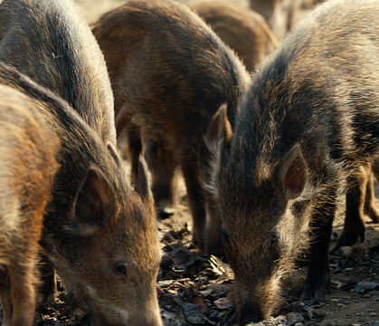
Authority over Evil
Mark 5:10-20
10 And he besought him much that he would not send them away out of the country.
11 Now there was there nigh unto the mountains a great herd of swine feeding.

Slide 27
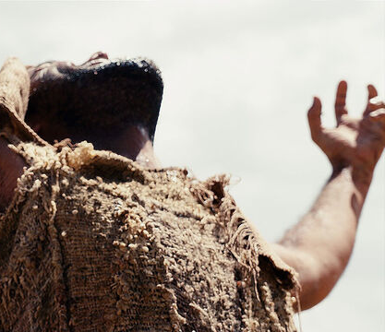
Authority over Evil
Mark 5:12-20
12 And all the devils besought him, saying, Send us into the swine, that we may enter into them.

Slide 28
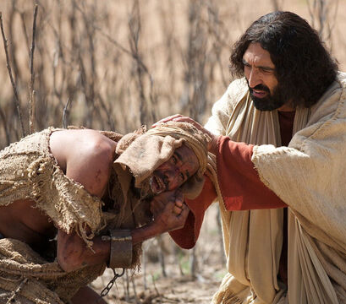
Authority over Evil
Mark 5:13-20
13 And forthwith Jesus gave them leave. And the unclean spirits went out, and entered into the swine: and the herd ran violently down a steep place into the sea, (they were about two thousand;) and were choked in the sea.

Slide 29
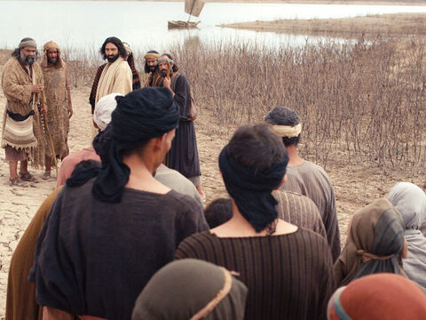
Authority over Evil
Mark 5:14-20
14 And they that fed the swine fled, and told it in the city, and in the country. And they went out to see what it was that was done.

Slide 30
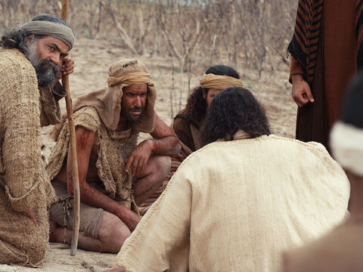
Authority over Evil
Mark 5:15-20
15 And they come to Jesus, and see him that was possessed with the devil, and had the legion, sitting, and clothed, and in his right mind: and they were afraid.

Slide 31
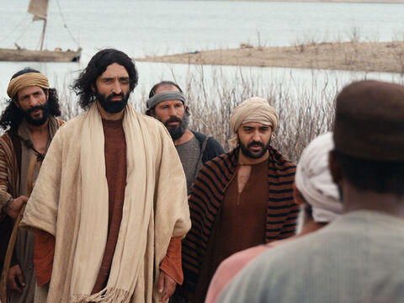
Authority over Evil
Mark 5:16-20
16 And they that saw it told them how it befell to him that was possessed with the devil, and also concerning the swine.

Slide 32
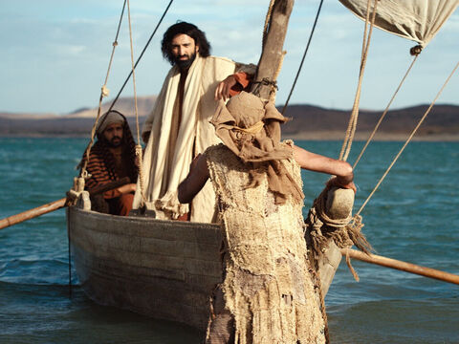
Authority over Evil
Mark 5:17-20
17 And they began to pray him to depart out of their coasts.
18 And when he was come into the ship, he that had been possessed with the devil prayed him that he might be with him.

Slide 33
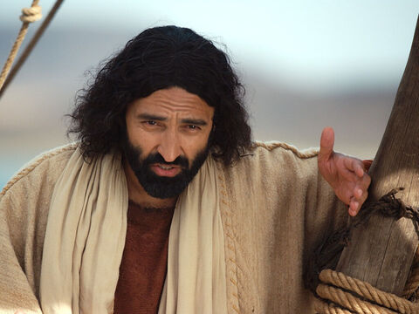
Authority over Evil
Mark 5:19-20
19 Howbeit Jesus suffered him not, but saith unto him, Go home to thy friends, and tell them how great things the Lord hath done for thee, and hath had compassion on thee.

Slide 34
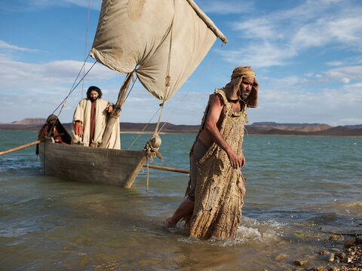
Authority over Evil
Mark 5:20
20 And he departed, and began to publish in Decapolis how great things Jesus had done for him: and all men did marvel.

Slide 35
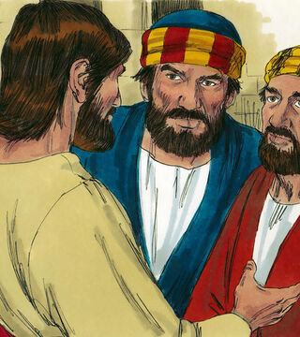
Whose Authority?
Matthew 10:1, 7-8
And when he had called unto him his twelve disciples, he gave them power against unclean spirits, to cast them out, and to heal all manner of sickness and all manner of disease.

Slide 36
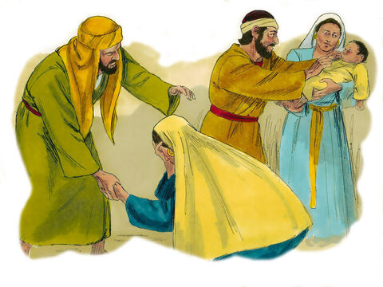
Whose Authority?
Matthew 10:7-8
7 And as ye go, preach, saying, The kingdom of heaven is at hand.
8 Heal the sick, cleanse the lepers, raise the dead, cast out devils: freely ye have received, freely give.

Slide 37
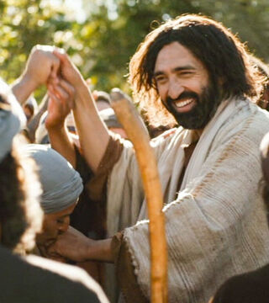
Whose Authority?
Luke 10:17-19
17 And the seventy returned again with joy, saying, Lord, even the devils are subject unto us through thy name.
18 And he said unto them, I beheld Satan as lightning fall from heaven.

Slide 38
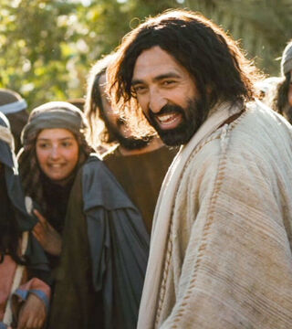
Whose Authority?
Matthew 10:7-8
19 Behold, I give unto you power to tread on serpents and scorpions, and over all the power of the enemy: and nothing shall by any means hurt you

Slide 39
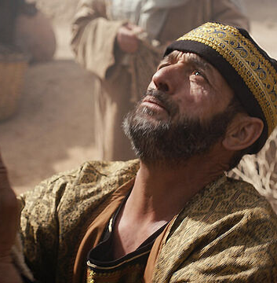
Authority over DEATH
Mark 5:21-34
21 And when Jesus was passed over again by ship unto the other side, much people gathered unto him: and he was nigh unto the sea.
22 And, behold, there cometh one of the rulers of the synagogue, Jairus by name; and when he saw him, he fell at his feet,

Slide 40
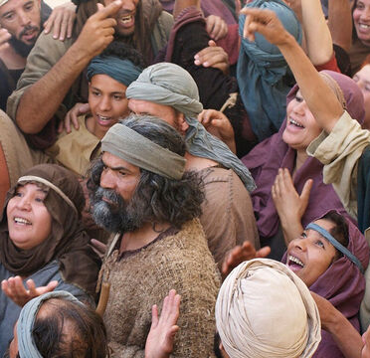
Authority over DEATH
Mark 5:23-34
23 And besought him greatly, saying, My little daughter lieth at the point of death: I pray thee, come and lay thy hands on her, that she may be healed; and she shall live.
24 And Jesus went with him; and much people followed him, and thronged him.

Slide 41
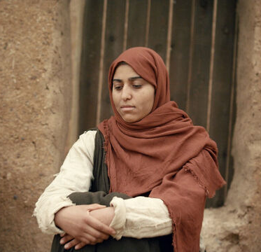
Authority over Uncleanness
Mark 5:25-34
25 And a certain woman, which had an issue of blood twelve years,
26 And had suffered many things of many physicians, and had spent all that she had, and was nothing bettered, but rather grew worse,

Slide 42

Authority over Uncleanness
Mark 5:27-34
27 When she had heard of Jesus, came in the press behind, and touched his garment.
28 For she said, If I may touch but his clothes, I shall be whole.
29 And straightway the fountain of her blood was dried up; and she felt in her body that she was healed of that plague.

Slide 43

UNCLEAN
Leviticus 15:19-28
19 And if a woman have an issue, and her issue in her flesh be blood, she shall be put apart seven days: and whosoever toucheth her shall be unclean until the even.
20 And every thing that she lieth upon in her separation shall be unclean: every thing also that she sitteth upon shall be unclean.

Slide 44
UNCLEAN
Leviticus 15:21-28
21 And whosoever toucheth her bed shall wash his clothes, and bathe himself in water, and be unclean until the even.
22 And whosoever toucheth any thing that she sat upon shall wash his clothes, and bathe himself in water, and be unclean until the even.

Slide 45
UNCLEAN
Leviticus 15:23-28
23 And if it be on her bed, or on any thing whereon she sitteth, when he toucheth it, he shall be unclean until the even.
24 And if any man lie with her at all, and her flowers be upon him, he shall be unclean seven days; and all the bed whereon he lieth shall be unclean.

Slide 46
UNCLEAN
Leviticus 15:25-28
25 And if a woman have an issue of her blood many days out of the time of her separation, or if it run beyond the time of her separation; all the days of the issue of her uncleanness shall be as the days of her separation: she shall be unclean.

Slide 47
UNCLEAN
Leviticus 15:26-28
26 Every bed whereon she lieth all the days of her issue shall be unto her as the bed of her separation: and whatsoever she sitteth upon shall be unclean, as the uncleanness of her separation.

Slide 48
UNCLEAN
Leviticus 15:26-28
27 And whosoever toucheth those things shall be unclean, and shall wash his clothes, and bathe himself in water, and be unclean until the even.
28 But if she be cleansed of her issue, then she shall number to herself seven days, and after that she shall be clean.

Slide 49
UNCLEAN
Leviticus 5:2-3
2 Or if a soul touch any unclean thing, whether it be a carcase of an unclean beast, or a carcase of unclean cattle, or the carcase of unclean creeping things, and if it be hidden from him; he also shall be unclean, and guilty.
3 Or if he touch the uncleanness of man, whatsoever uncleanness it be that a man shall be defiled withal, and it be hid from him; when he knoweth of it, then he shall be guilty.

Slide 50
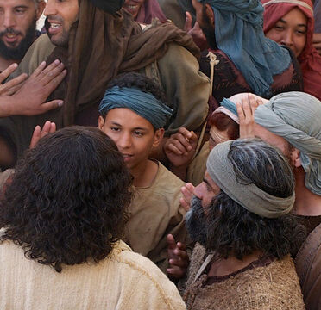
Authority over Uncleanness
Mark 5:30-34
30 And Jesus, immediately knowing in himself that virtue had gone out of him, turned him about in the press, and said, Who touched my clothes?
31 And his disciples said unto him, Thou seest the multitude thronging thee, and sayest thou, Who touched me?

Slide 51
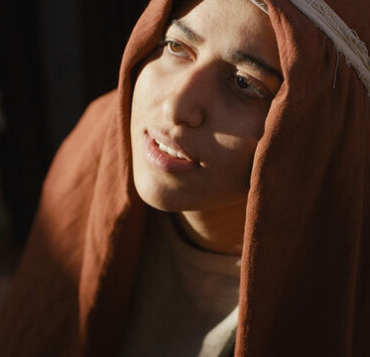
Authority over Uncleanness
Mark 5:32-34
32 And he looked round about to see her that had done this thing.
33 But the woman fearing and trembling, knowing what was done in her, came and fell down before him, and told him all the truth.

Slide 52
Authority over Uncleanness
Mark 5:34
34 And he said unto her, Daughter, thy faith hath made thee whole; go in peace, and be whole of thy plague.

Slide 53
SDABC on Mark 5:28
“
The touch that brought healing to the woman would be considered by the rabbis to have brought ritual uncleanness upon Christ.
”

Slide 54
God’s Cleansing is More Powerful than Our Dirt
“
“Who can say, I have made my heart clean, I am pure from my sin?” -Proverbs 20:9
”
“But we are all as an unclean thing, and all our righteousnesses are as filthy rags;” -Isaiah 64:6a
“Then will I sprinkle clean water upon you, and ye shall be clean: from all your filthiness, and from all your idols, will I cleanse you.” –Ezekiel 36:25

Slide 55
God’s Cleansing is More Powerful than Our Dirt
“
“And such were some of you: but ye are washed, but ye are sanctified, but ye are justified in the name of the Lord Jesus, and by the Spirit of our God.” -1 Corinthians 6:11
”
“Let us draw near with a true heart in full assurance of faith, having our hearts sprinkled from an evil conscience, and our bodies washed with pure water.-Hebrews 10:22

Slide 56
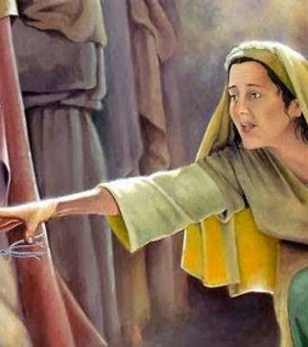
Whose Authority?
SDABC on Mark 5:30
The will of the Father answered the unspoken plea of the woman through Him. It should be remembered that all Christ’s miracles were “wrought by the power of God through the ministration of the angels” (Desire of Ages p.143).

Slide 57
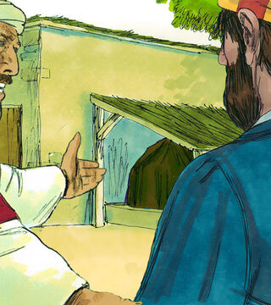
Whose Authority?
Acts 10:9-16, 27-29
9 On the morrow, as they went on their journey, and drew nigh unto the city, Peter went up upon the housetop to pray about the sixth hour:
10 And he became very hungry, and would have eaten: but while they made ready, he fell into a trance,

Slide 58
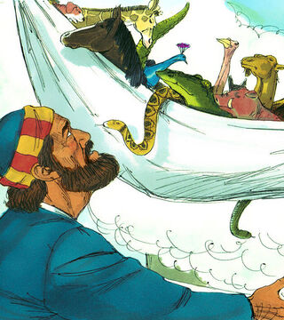
Whose Authority?
Acts 10:11-16, 27-29
11 And saw heaven opened, and a certain vessel descending upon him, as it had been a great sheet knit at the four corners, and let down to the earth:
12 Wherein were all manner of fourfooted beasts of the earth, and wild beasts, and creeping things, and fowls of the air.

Slide 59
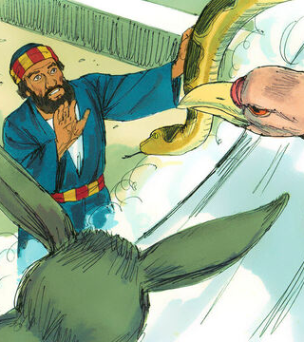
Whose Authority?
Acts 10:13-16, 27-29
13 And there came a voice to him, Rise, Peter; kill, and eat.
14 But Peter said, Not so, Lord; for I have never eaten any thing that is common or unclean.
15 And the voice spake unto him again the second time, What God hath cleansed, that call not thou common.

Slide 60
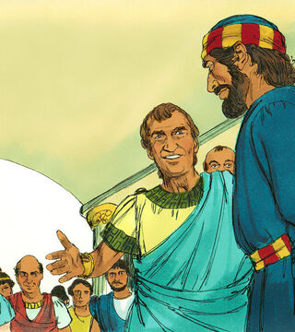
Whose Authority?
Acts 10:16, 27-29
16 This was done thrice: and the vessel was received up again into heaven.
…
27 And as he talked with him, he went in, and found many that were come together.

Slide 61
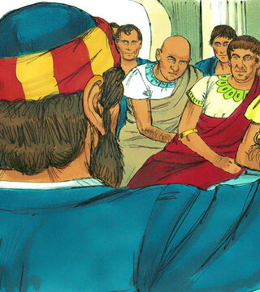
Whose Authority?
Acts 10:28-29
28 And he said unto them, Ye know how that it is an unlawful thing for a man that is a Jew to keep company, or come unto one of another nation; but God hath shewed me that I should not call any man common or unclean.

Slide 62
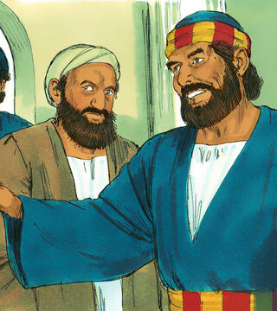
Whose Authority?
Acts 10:29
29 Therefore came I unto you without gainsaying, as soon as I was sent for: I ask therefore for what intent ye have sent for me?

Slide 63

Whose Authority?
Matthew 15:18-19
But those things which proceed out of the mouth come forth from the heart; and they defile the man.
For out of the heart proceed evil thoughts, murders, adulteries, fornications, thefts, false witness, blasphemies:
These are the things which defile a man: but to eat with unwashen hands defileth not a man.

Slide 64
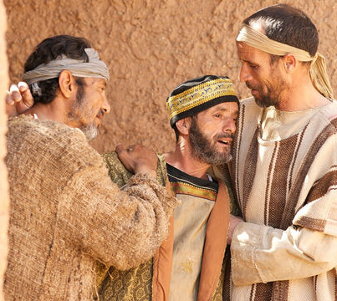
Authority over Death
Mark 5:35-43
35 While he yet spake, there came from the ruler of the synagogue's house certain which said, Thy daughter is dead: why troublest thou the Master any further?

Slide 65
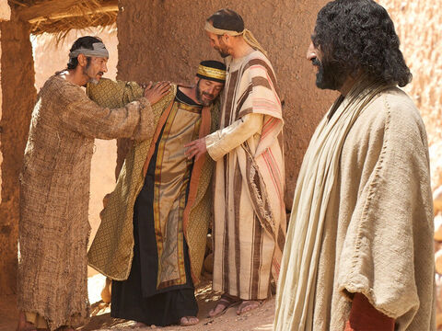
Authority over Death
Mark 5:36-43
36 As soon as Jesus heard the word that was spoken, he saith unto the ruler of the synagogue, Be not afraid, only believe.

Slide 66
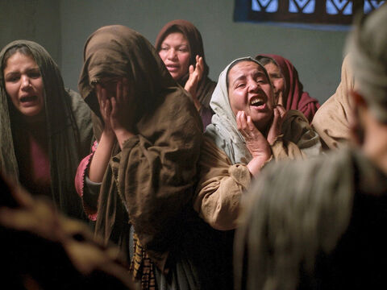
Authority over Death
Mark 5:37-43
37 And he suffered no man to follow him, save Peter, and James, and John the brother of James.
38 And he cometh to the house of the ruler of the synagogue, and seeth the tumult, and them that wept and wailed greatly.

Slide 67
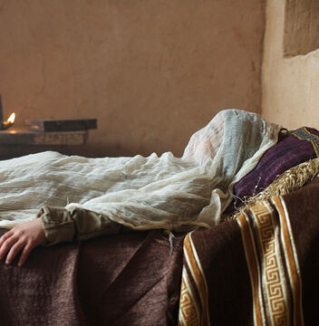
Authority over Death
Mark 5:39-43
39 And when he was come in, he saith unto them, Why make ye this ado, and weep? the damsel is not dead, but sleepeth.

Slide 68
Authority over Death
Mark 5:40-43
40 And they laughed him to scorn. But when he had put them all out, he taketh the father and the mother of the damsel, and them that were with him, and entereth in where the damsel was lying.

Slide 69

Authority over Death
Mark 5:41-43
41 And he took the damsel by the hand, and said unto her, Talitha cumi; which is, being interpreted, Damsel, I say unto thee, arise.

Slide 70

Authority over Death
Mark 5:42-43
42 And straightway the damsel arose, and walked; for she was of the age of twelve years. And they were astonished with a great astonishment.

Slide 71

Authority over Death
Mark 5:43
43 And he charged them straitly that no man should know it; and commanded that something should be given her to eat.

Slide 72
Whose Authority?
Matthew 10:7-8
7 And as ye go, preach, saying, The kingdom of heaven is at hand.
8 Heal the sick, cleanse the lepers, raise the dead, cast out devils: freely ye have received, freely give.

Slide 73

Whose Authority?
Acts 9:36-42
36 Now there was at Joppa a certain disciple named Tabitha, which by interpretation is called Dorcas: this woman was full of good works and almsdeeds which she did.

Slide 74

Whose Authority?
Acts 9:37-42
37 And it came to pass in those days, that she was sick, and died: whom when they had washed, they laid her in an upper chamber.

Slide 75

Whose Authority?
Acts 9:38-42
38 And forasmuch as Lydda was nigh to Joppa, and the disciples had heard that Peter was there, they sent unto him two men, desiring him that he would not delay to come to them.

Slide 76

Whose Authority?
Acts 9:39-42
39 Then Peter arose and went with them. When he was come, they brought him into the upper chamber: and all the widows stood by him weeping, and shewing the coats and garments which Dorcas made, while she was with them.

Slide 77

Whose Authority?
Acts 9:40-42
40 But Peter put them all forth, and kneeled down, and prayed; and turning him to the body said, Tabitha, arise. And she opened her eyes: and when she saw Peter, she sat up.

Slide 78

Whose Authority?
Acts 9:41-42
41 And he gave her his hand, and lifted her up, and when he had called the saints and widows, presented her alive.
42 And it was known throughout all Joppa; and many believed in the Lord.

Slide 79

Authority at Home
Mark 6:1-6
1 And he went out from thence, and came into his own country; and his disciples follow him.
2 And when the sabbath day was come, he began to teach in the synagogue: and many hearing him were astonished, saying, From whence hath this man these things? and what wisdom is this which is given unto him, that even such mighty works are wrought by his hands?

Slide 80

Authority at Home
Mark 6:1-6
3 Is not this the carpenter, the son of Mary, the brother of James, and Joses, and of Juda, and Simon? and are not his sisters here with us? And they were offended at him.
4 But Jesus, said unto them, A prophet is not without honour, but in his own country, and among his own kin, and in his own house.

Slide 81

Authority at Home
Mark 6:1-6
5 And he could there do no mighty work, save that he laid his hands upon a few sick folk, and healed them.
6 And he marvelled because of their unbelief. And he went round about the villages, teaching.

Slide 82
The Desire of Ages p. 587
“
In this generation there are many who are treading on the same ground as were the unbelieving Jews. They have witnessed the manifestation of the power of God; the Holy Spirit has spoken to their hearts; but they cling to their unbelief and resistance. God sends them warnings and reproof, but they are not willing to confess their errors, and they reject His message and His messenger. The very means He uses for their recovery becomes to them a stone of stumbling.
”

Slide 83

Authority Delegated
Mark 6:7-13
7 And he called unto him the twelve, and began to send them forth by two and two; and gave them power over unclean spirits;

Slide 84

Authority Delegated
Mark 6:8-13
8 And commanded them that they should take nothing for their journey, save a staff only; no scrip, no bread, no money in their purse:

Slide 85

Authority Delegated
Mark 6:9-13
9 But be shod with sandals; and not put on two coats.

Slide 86

Authority Delegated
Mark 6:10-13
10 And he said unto them, In what place soever ye enter into an house, there abide till ye depart from that place.

Slide 87

Authority Delegated
Mark 6:11-13
11 And whosoever shall not receive you, nor hear you, when ye depart thence, shake off the dust under your feet for a testimony against them. Verily I say unto you, It shall be more tolerable for Sodom and Gomorrha in the day of judgment, than for that city.

Slide 88

Authority Delegated
Mark 6:12-13
12 And they went out, and preached that men should repent.
13 And they cast out many devils, and anointed with oil many that were sick, and healed them.

Slide 89
Thank you!
Happy Sabbath!!

